Slide 1
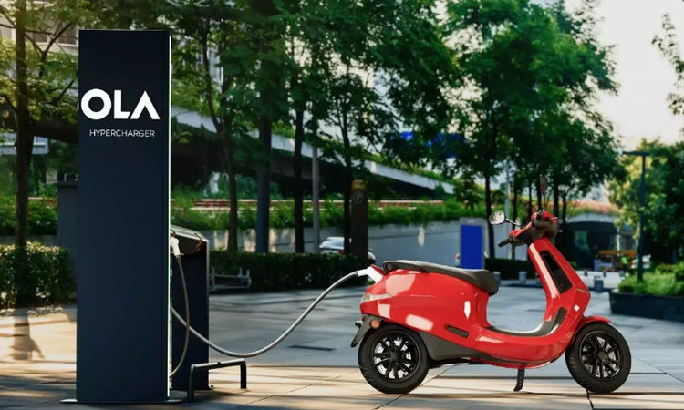
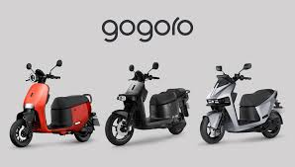
IPO ANALYSIS
A COMPARATIVE STUDY OF ASIAN EV COMPANIES: OLA ELECTRIC vs GOGORO INC.
A COMPARATIVE STUDY ON ASIAN EV MARKET
By Gomathi U – IBFA June 2025

Slide 2
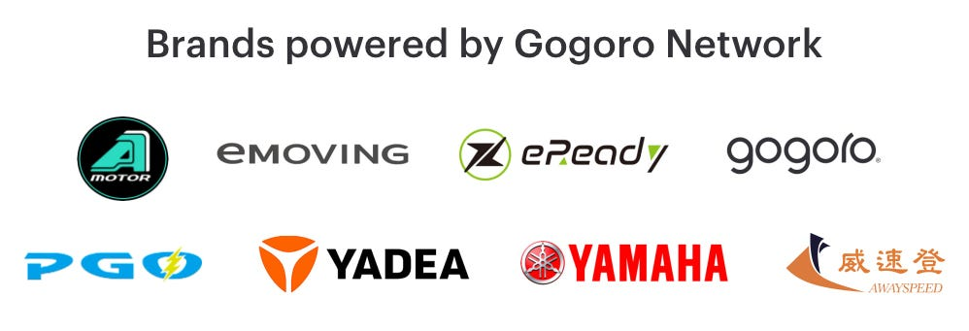
EV- 2W LANDSCAPE
INDIA – EV 2W MARKET units sold
FY 24-25 (2)
Factors | INDIA | TAIWAN
Market size | USD 1.6Bn | USD 178M
CAGR - 2033 | 28.3% | 11.3%
Market maturity | Early Exponetial | Saturated
Focus | Domestic + Exports | Domestic
Population | 1.4Bn | 23M
TAIWAN – 2W MARKET (3)

Slide 3
COMPANY OVERVIEW
Gogoro is US listed Taiwanese company engaged in EV 2W and energy storage market
Merged with Poema Global, a SPAC company in Cayman islands, in April 2022
First large scale battery swapping network that shed the limelight of EV 2W
Operates over 2,500 Go Stations and 500K+ battery subscribers across Taiwan and expanding into SEA markets.
Particulars | Ola Electric | Gogoro
Founded | 2017 | 2011
Founder, CEO | Bhavish Aggarwal | Horace Luke, Matt Taylor
Market Cap | $ 2.5Bn | $ 61.7M
Enterprise V | $ 2.5Bn | $ 446M
P/E ratio | (12.3)x | (0.7)x
Company’s share | 30% of total | 90% of total
Ola Electric Mobility Limited is a pure-EV manufacturer founded as a subsidiary of ANI Technologies
Expanding in India’s EV segment, with launch of Ola Shakti and Motorcycle model
India’s first EV 2W manufacturer to go public

Slide 4
IPO SNAPSHOT
OLA ELECTRIC
GOGORO
PARTICULARS | OLA ELECTRIC | GOGORO
YEAR – IPO EV – 2W launch | 2024 2021 | 2022 2015
LISTED UNDER | NSE & BSE | NASDAQ
ISSUE TYPE | Fresh Issue cum OFS | Under SPAC merger
ISSUE PRICE | ₹76 | $ 10
ISSUE SIZE | ₹6145.56 Cr | $345M –SPAC
LISTING GAINS | 20% | 10%
Subscribed 4.45x in retail & 5.5x in institutional (1)
In Oct 2023, Raised Funding to set up Ola Gigafactory
To expand cell manufacturing capacity, support R&D at Giga factory in Krishnagiri, Tamilnadu
To expand operations in China, India, SEA and support R&D for battery swapping network.
Fixed Valuation through SPAC deal – no retail price discovery

Slide 5
VALUATION
Ola Valuation basis : Book Building
Valued at IPO | USD 4 Bn
Financial Multiples
BASIS | PRICE PER EQ SHARE
WACA – Primary | ₹47.00
WACA – Secondary | ₹87.83
Price Band | ₹72 - ₹76
Cap price Multiple | 1.62 (76/47)
Listed Price | ₹76 (47*1.62)
OLA | 6.11x | (30.84)x
PEER LISTED CO. | EV/ REV | EV / EBITDA
TVS MOTORS | 3.52x | 24.58x
EICHER MOTORS | 7.83x | 22.14x
BAJAJ AUTO | 5.92x | 25.39x
HERO MOTOR | 2.84x | 17.62x
GOGORO’S VALUATION
Pre-IPO valuation (sept 22) | USD 2.3 Bn
Valuation basis | Forward Revenue Projection
Valuation concern | Overvaluation (negate fin. metrics)
P/E ratio | (0.7)x
GOGORO | 1.15x
PEER LISTED CO. | EV/ REV
NIU TECHNOLOGIES | 1.74x
YADEA | 0.98x

Slide 6
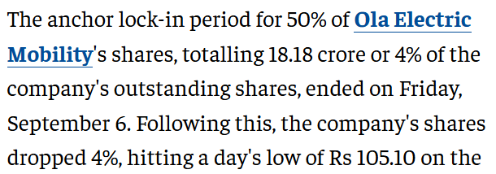
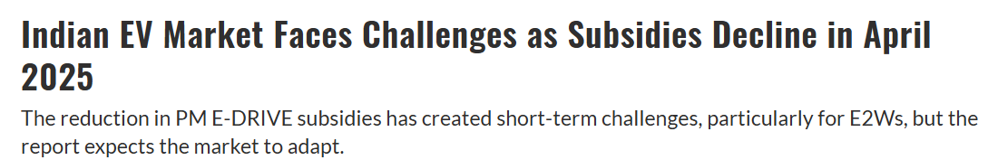
POST –IPO PERFORMANCE
OLA ELECTRIC
Ola Electric’s share price has shown signs of stabilization post-IPO despite subsidy cuts in April 2025.
Is investing in in-house manufacturing to control its supply chain and drive down costs.
Entered into energy storage market in 2025 with OLA SHAKTHI
The company’s effort in developing own Bharat Cells for batteries and ferrite motors - rare-earth free motors can restore investor sentiment.
Sept 6 2024
Jan 11-2024

Slide 7
POST –IPO PERFORMANCE
GOGORO INC
Gogoro has shown declining trend since the IPO listing. Various reasons being:
the news about Gachaco, Inc.,
Lending of swapping networks to market rivals,
JP Morgan gave the stock an underweight rating since the scooter sales in Taiwan is declining year by year.
NASDAQ’s notice on delisting the stock if the share price didn’t rise above $1 in next 180 days.
Investors of Gogoro turned risk averse due to –
Capital intensive expansion plans
Slowing domestic demand
The company had technological strength but the execution risk kept investors cautious.
Jan 11-2024

Slide 8
High retail interest in Indian Market
INTERPRETATION
INVESTOR SENTIMENT:
Persistent demand but Cautious | High Caution and negative
Gradual recovery trend post-decline in price
Competitive threats to battery-swap models
The PBGN network impacts since 90% of market is in Taiwan
Persisting decline in 2W sales trend
Introduction of rare earth- free motors in 2W
Entry into battery storage systems
Tempered enthusiasm
Broader cooling in EV investor appetite post 2021
Battery-swap is capital intensive
Puts a lot of depreciative assets in books
Need to seek constant investments
Ola was valued at $4B during listing which is lower than the previous valuation of $5.4B(2023) despite making a loss of $189M loss in 2024
Leaned towards risk and skepticism

Slide 9
CONCLUSION
Both Ola Electric and Gogoro highlight different stages of EV market evolution — India’s high-growth vs Taiwan’s maturity.
The growing adaptation of Electric vehicles in India combined with Ola electric’s expansion into energy storage market and into E-motorcycles market promises high scalability and growth potential.
The future resilience for Gogoro depends on innovation and making the EV two-wheelers cheaper since it is the expensive among competitors.

Slide 10
BIBLIOGRAPHY
1. https://www.chittorgarh.com/ipo_subscription/ola-electric-ipo/1765/
2. https://www.olaelectric.com/
3. https://www.motorcyclesdata.com/2025/09/17/taiwan-motorcycles/
2. https://jmkresearch.com/indias-electric-vehicle-sales-crossed-2-million-in-cy2024/
4. https://tracxn.com/d/companies/gogoro/__9YODZOD3it8P-_zJ6x7VmFZJunEIClvZCNpcaVZzm90/funding-and-investors
5. https://www.moneycontrol.com/news/business/ipo/ola-electric-ipo-listing-stock-market-debut-rs-76-per-share-12791549.html
6. https://in.investing.com/equities/poema-global-holdings-historical-data
7. https://finance.yahoo.com/quote/OLAELEC.BO/history/

